Slide 1
INTRODUCTION
Our Team Members Are
Asik
Yeasin
Mizan
Shuvo
Riad
Alamin

Slide 2
Grammar
A → B A'
A' → + B A' | 𝜀
B → C B'
B' → * C B' | 𝜀
C → id | ( A )
INPUT STRING IS : id * id + id $
It is not ambiguous, left recursive, non-deterministic. So no need to eliminate ambiguity, left recursion or non-determinism.

Slide 3
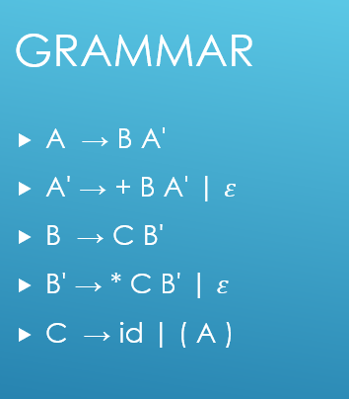
FIRST and FOLLOW Sets
FIRST AND FOLLOW SETS
String | FIRST | FOLLOW
A | {id, (} | {$, ) }
A' | {+, 𝜀 } | {$, ) }
B | {id, (} | {+, $, )}
B' | {*, 𝜀} | {+, $, ) }
C | {id, ( } | {*, +, $, ) }

Slide 4
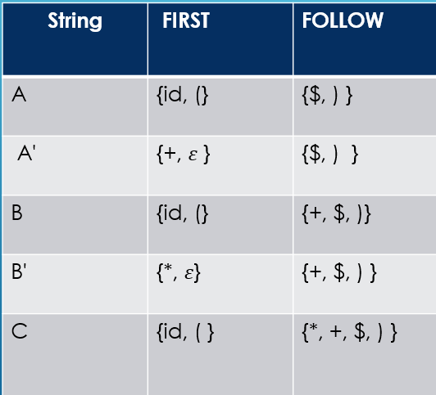
LL(1) Parse Table
LL(1) Parser Table:
Non-Terminal | id | + | * | ( | ) | $
A | A → B A' |  |  | A → B A'
A' |  | A' → + B A' |  |  | A' → 𝜀 | A' → 𝜀
B | B → C B' |  |  | B → C B'
B' |  | B' → 𝜀 | B' → * C B' |  | B' → 𝜀 | B' → 𝜀
C | C → id |  |  | C → ( A )

Slide 5

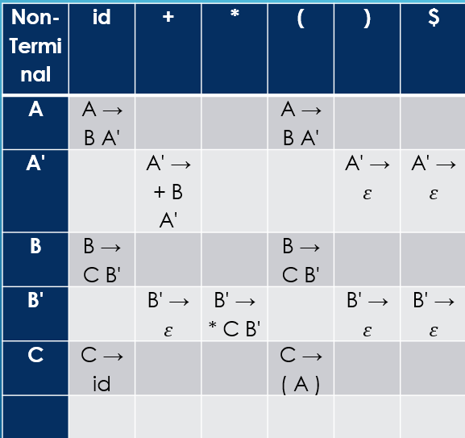
LL(1) Stack Implementation:
Stack | Input | Output
A $ | id * id + id $ | A → B A'
B A' $ | id * id + id $ | B → C B'
C B' A’ $ id B' A’ $ | id * id + id $ id * id + id $ | C → id POP
B' A' $ | * id + id $ | B' → * C B'
* C B' A' $ | * id + id $ | POP
C B' A’ $ id B' A’ $ | id + id $ id + id $ | C → id POP
B' A' $ | + id $ | B' → 𝜀
A' $ | + id $ | A' → + B A'
+ B A' $ | + id $ | POP
B A' $ | id $ | B → C B'
C B' A’ $ id B' A’ $ | id $ id $ | C → id POP
B' A' $ | $ | B' → 𝜀
A' $ | $ | A' → 𝜀
$ | $ | Accept

Slide 6
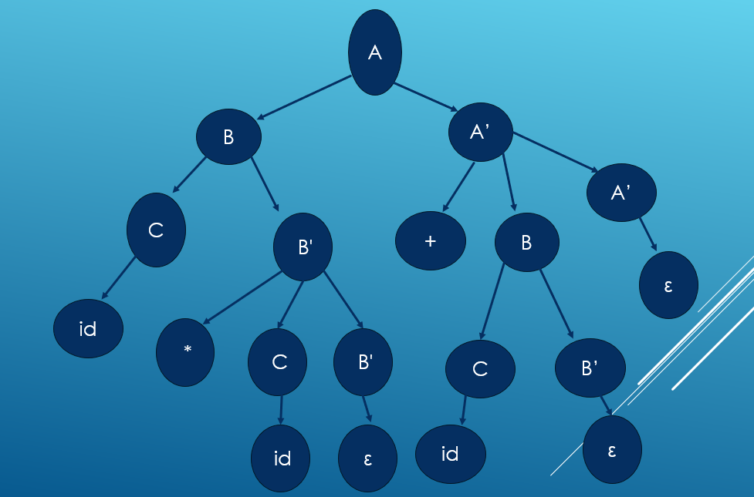
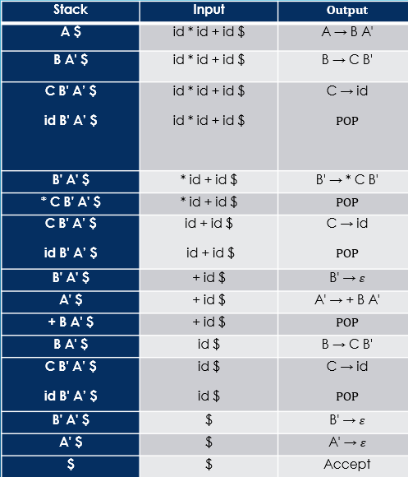
Parse Tree:

Slide 7
Conclusion
The input string id * id + id $ is successfully parsed using the given LL(1) grammar. The grammar is confirmed to be LL(1) compliant, as demonstrated by the construction of accurate FIRST and FOLLOW sets and a conflict-free parse table. The detailed parsing steps illustrate the derivation path clearly, showing how each production rule is applied and how the stack evolves during the process. This kind of analysis is particularly useful in the context of syntax analysis in compiler design, where LL(1) parsers are favored for their simplicity, efficiency, and deterministic behavior.

Slide 8
Fell free to ask any question
Thanks Everyone!

